Slide 1
INTERNATIONAL WOMEN’S DAY
Tuesday March 8th

Slide 3
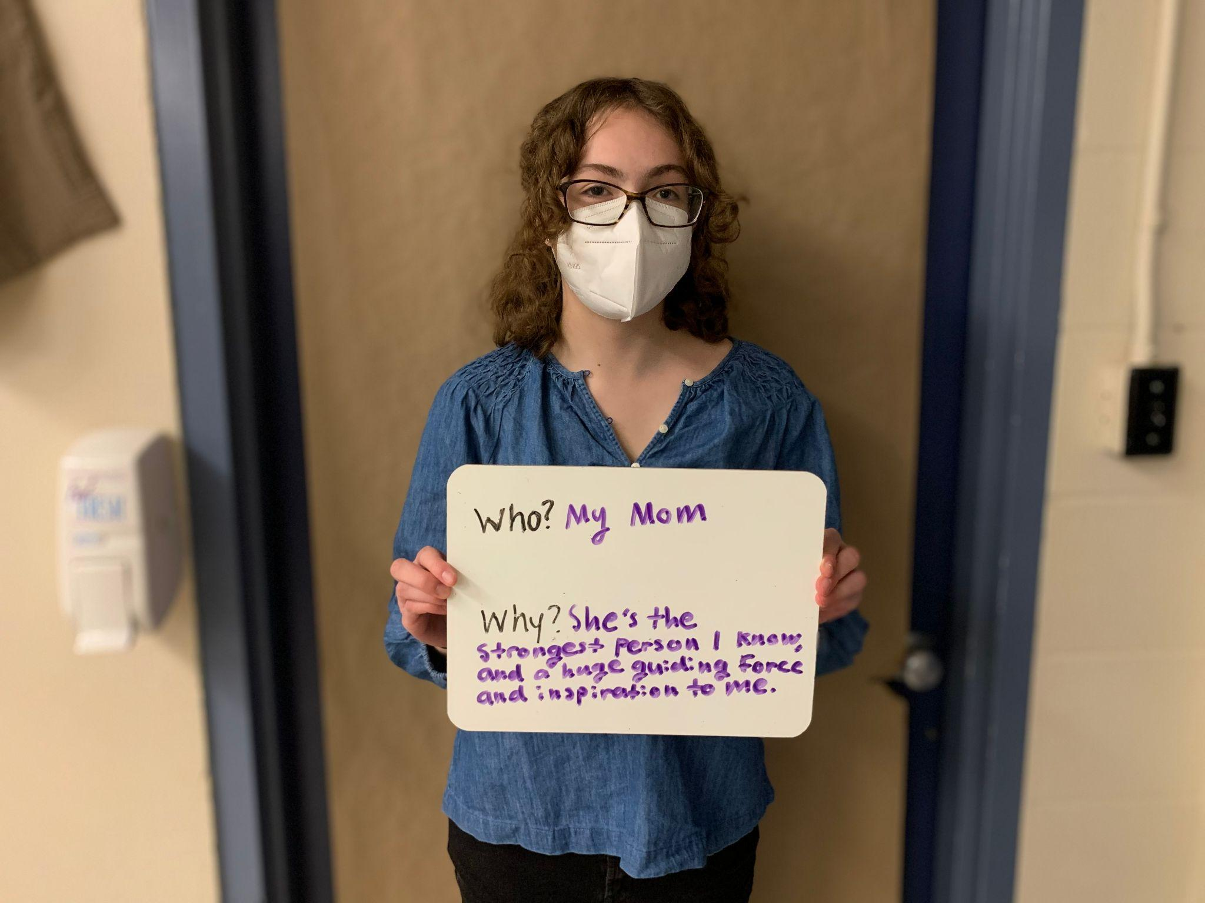

Slide 4
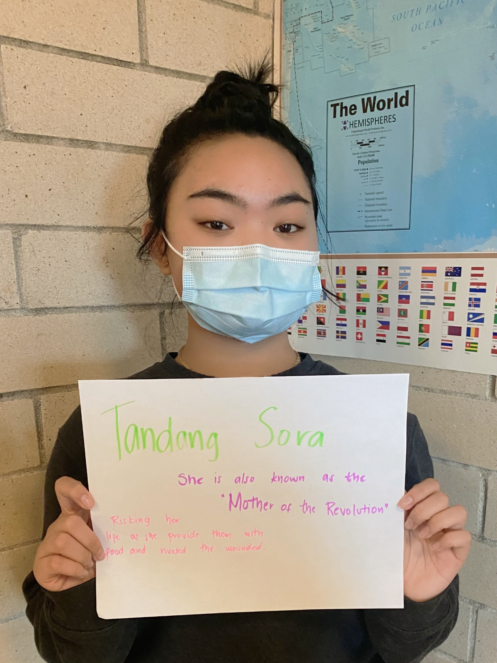

Slide 5
“I don’t believe in failure. It’s not a failure if you enjoy the process.”
– Oprah Winfrey

Slide 6
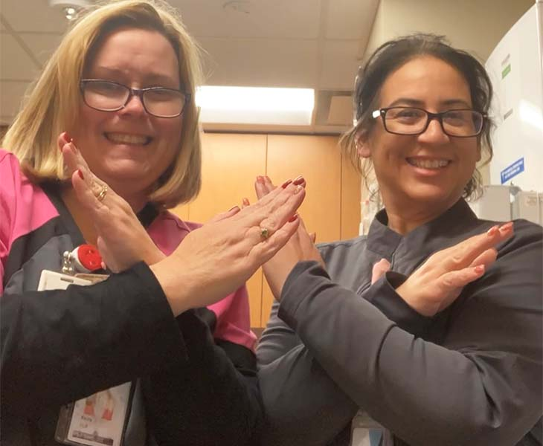

Slide 7
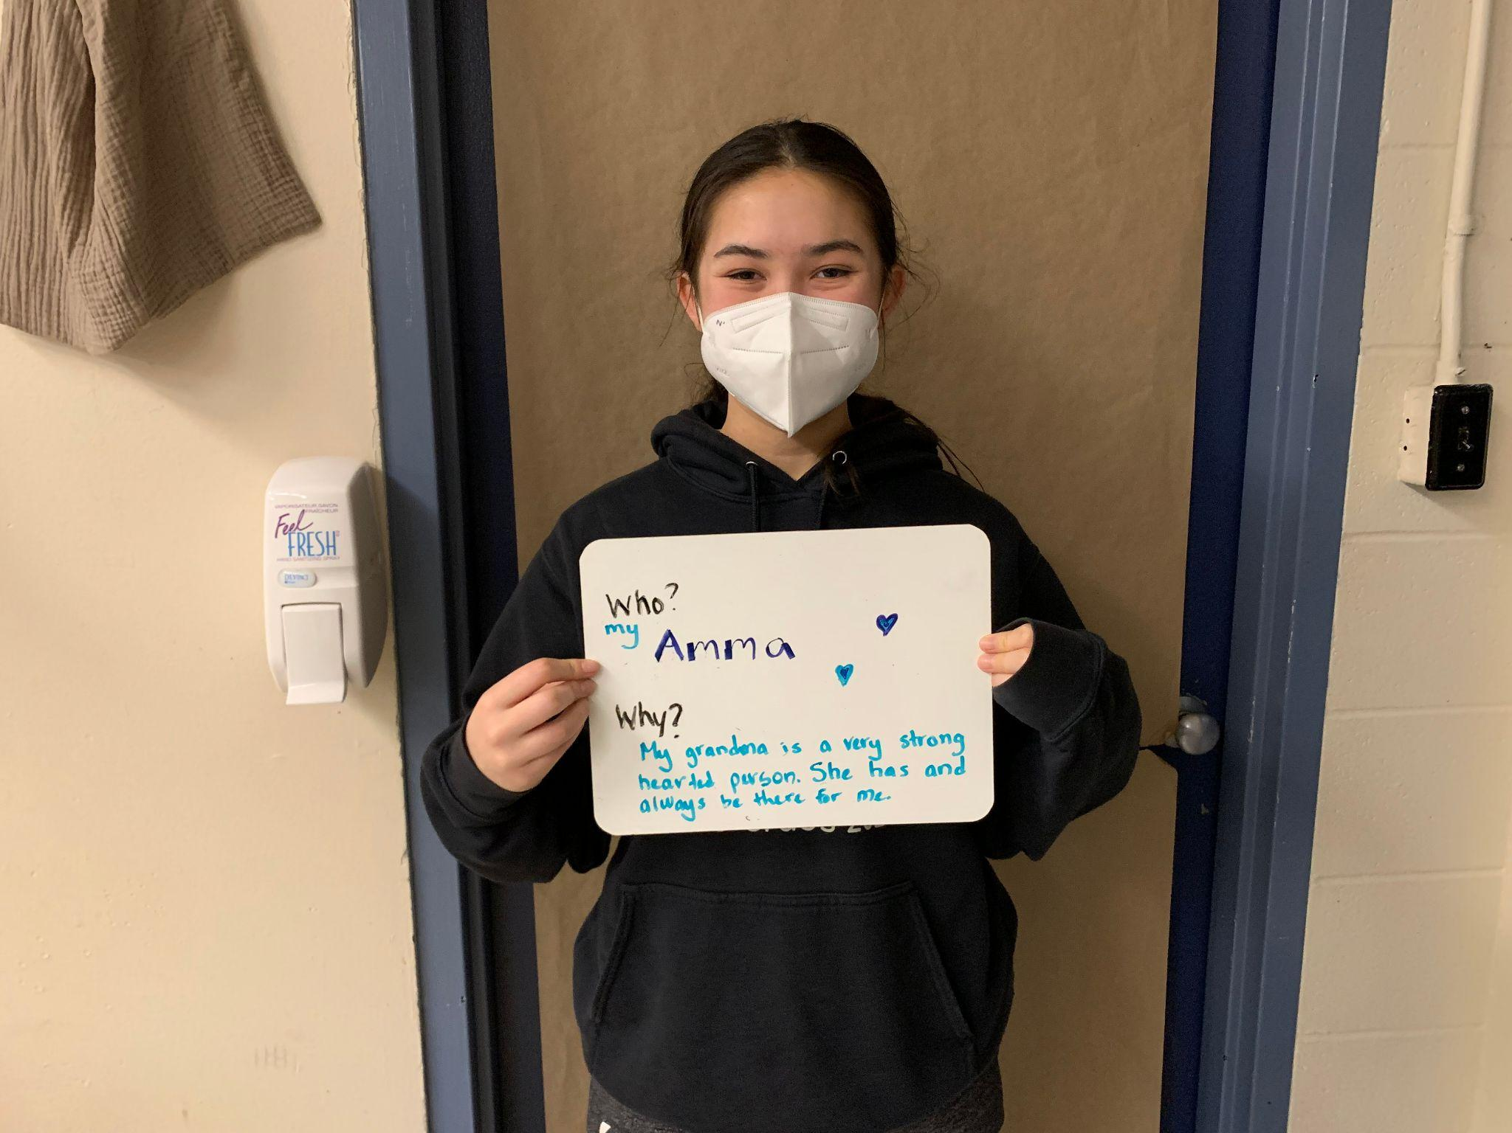

Slide 8
“Let go of who you think you’re supposed to be; embrace who you are.”
– Brené Brown

Slide 9
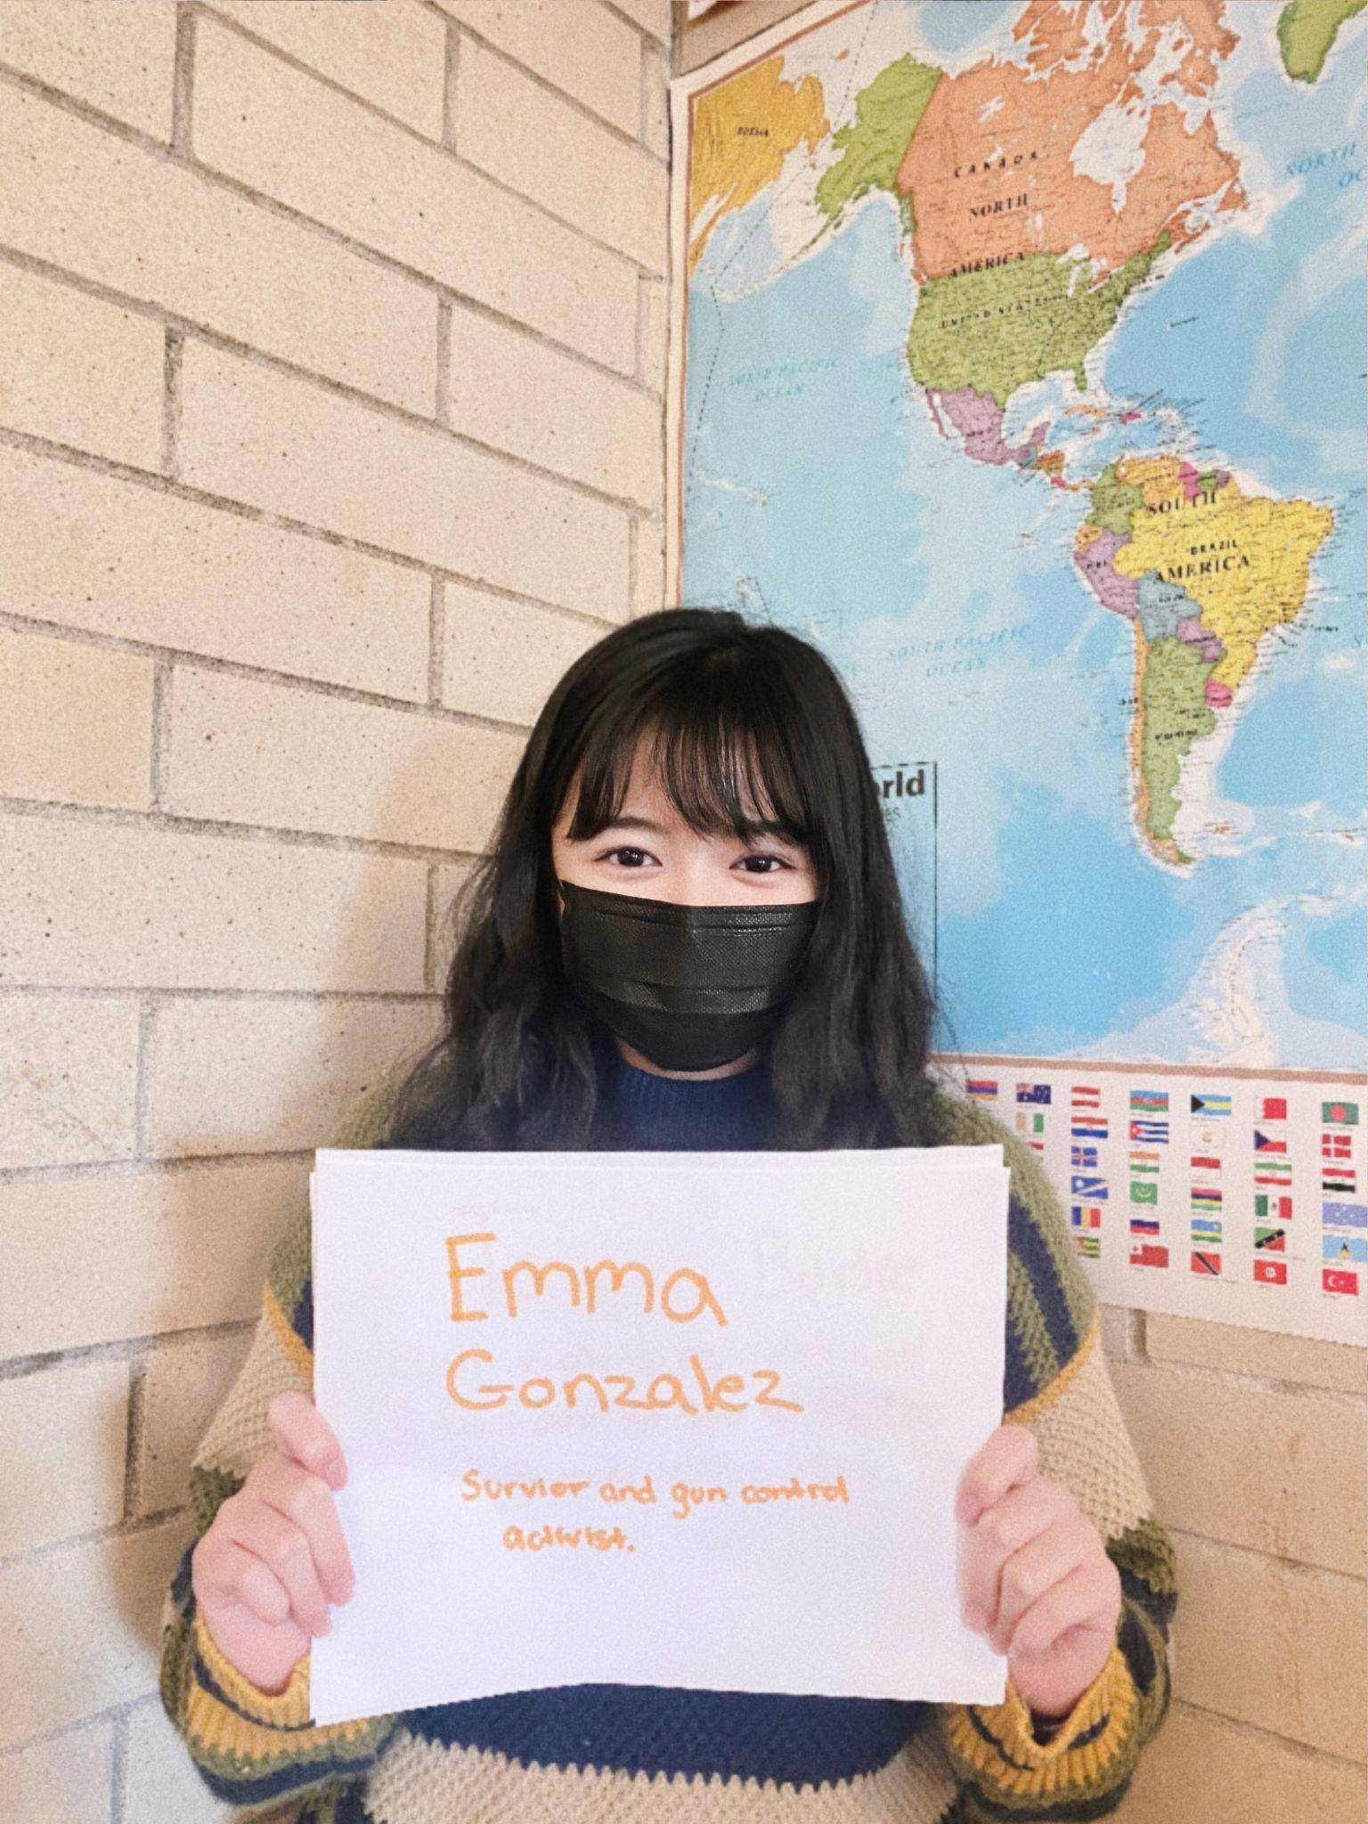

Slide 10
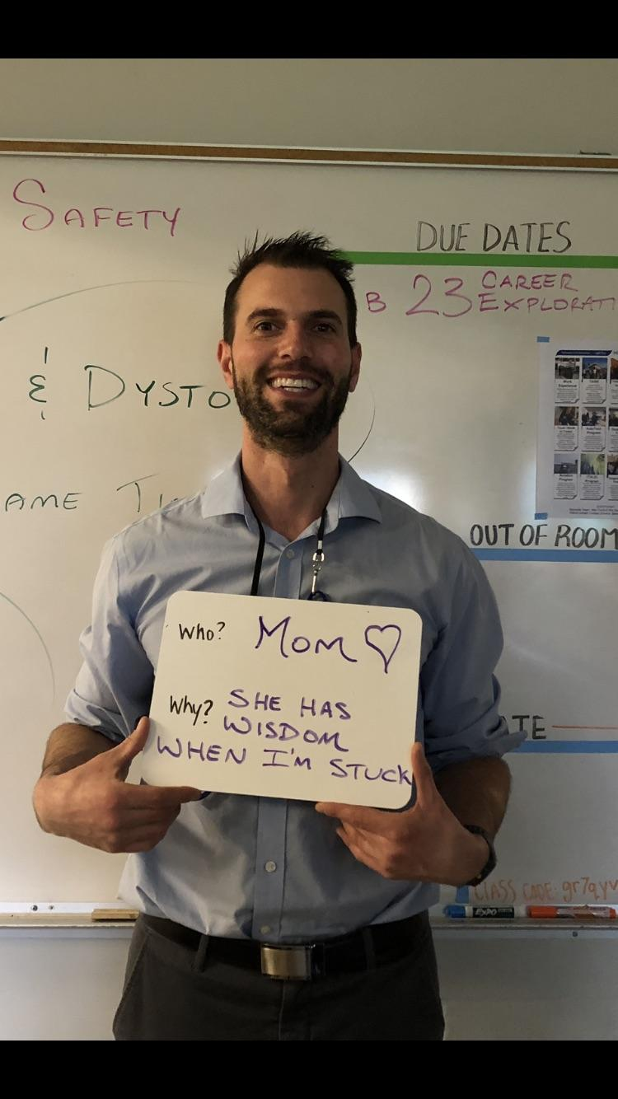

Slide 12
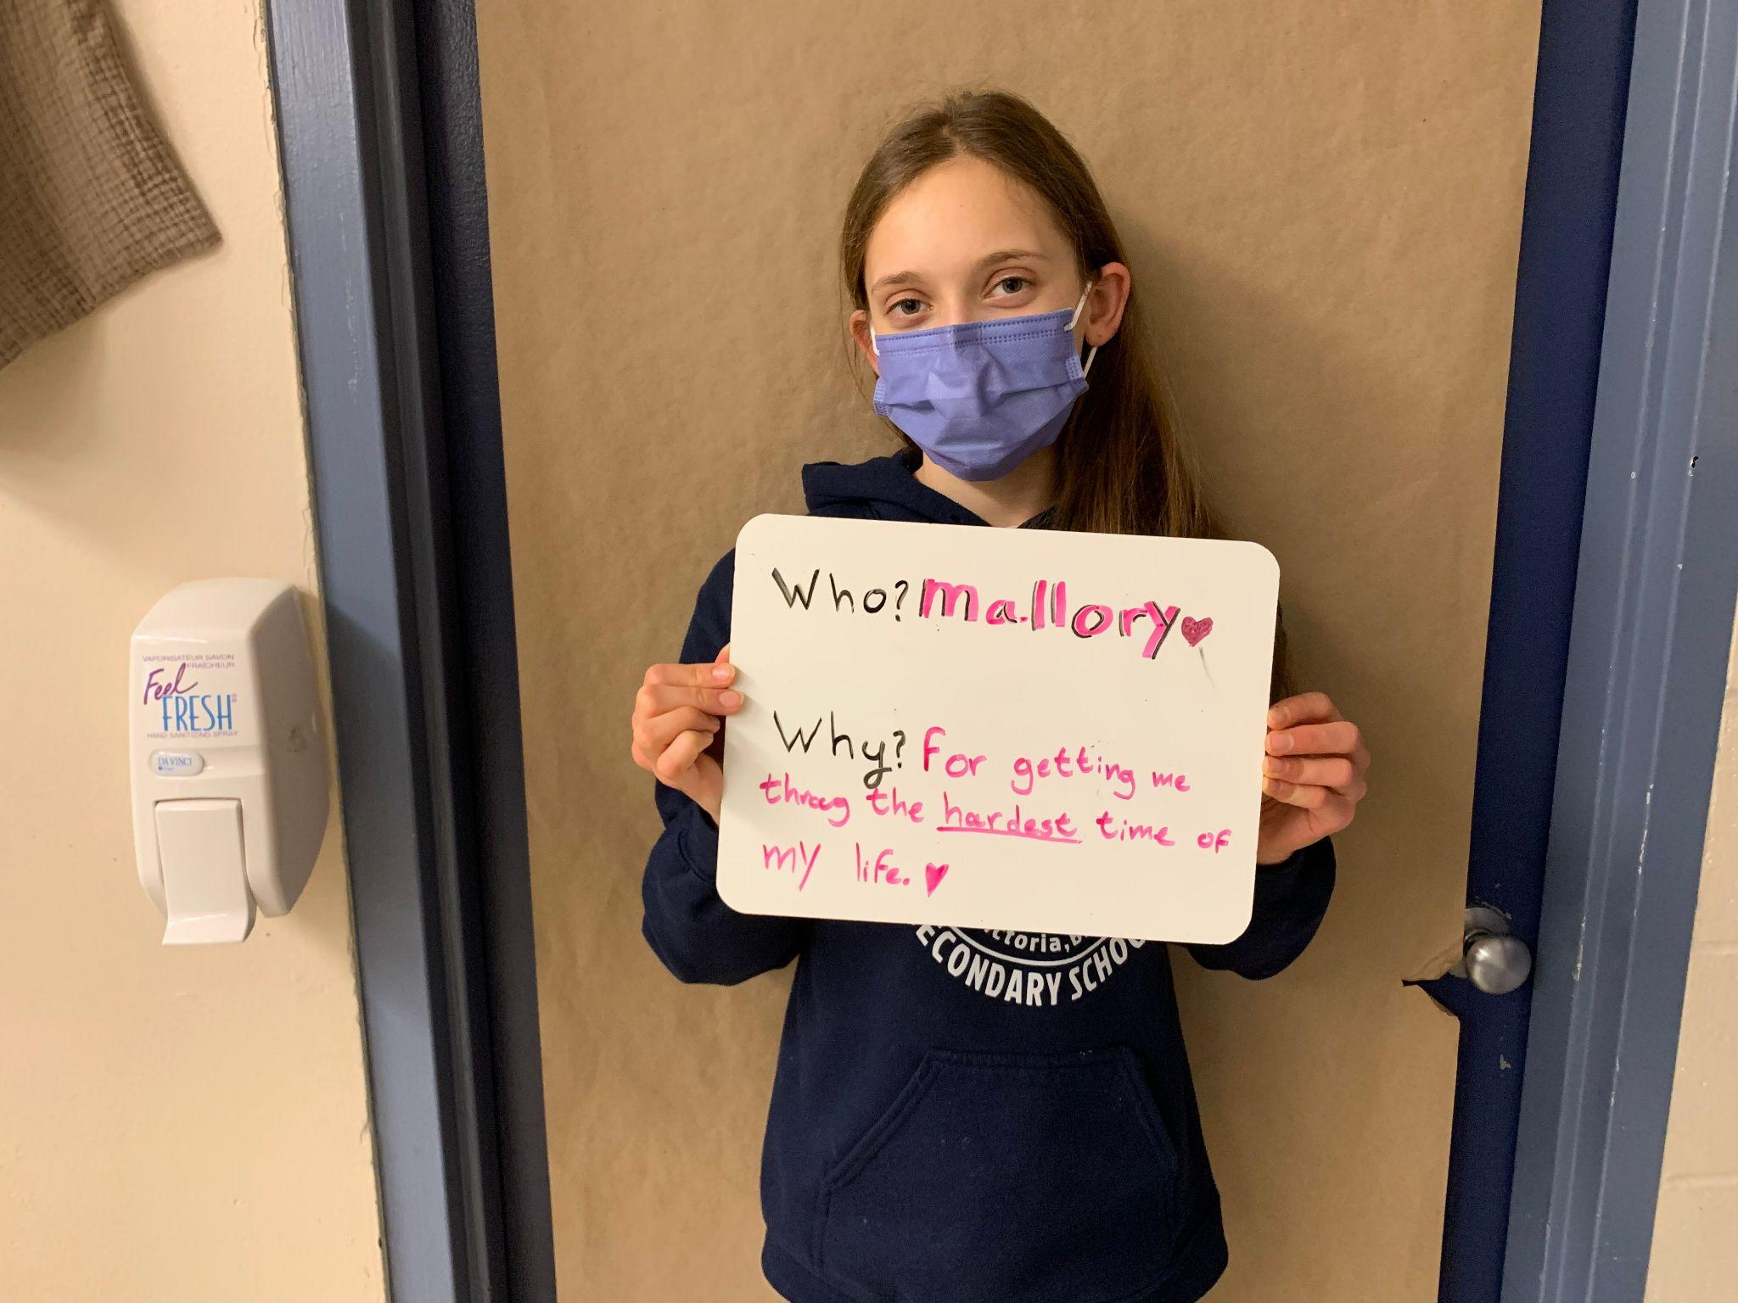

Slide 13
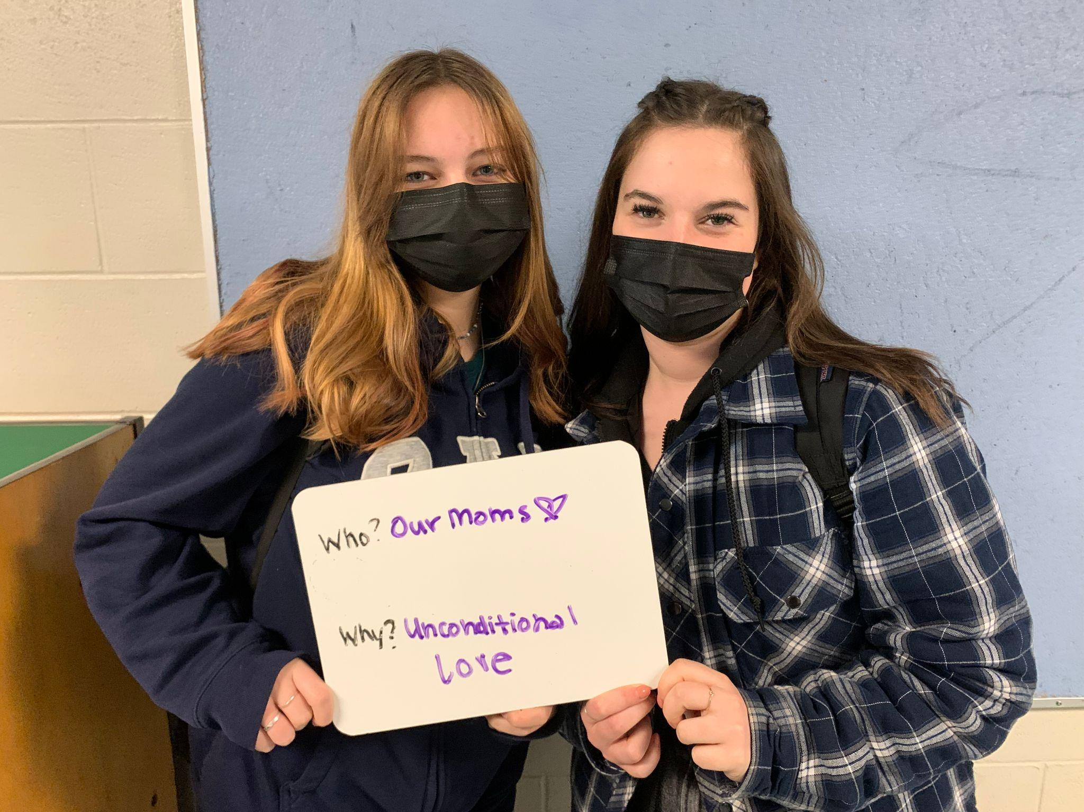

Slide 14
“The success of every woman should be the inspirational to another. We should raise each other up.”
-Serena Williams

Slide 15
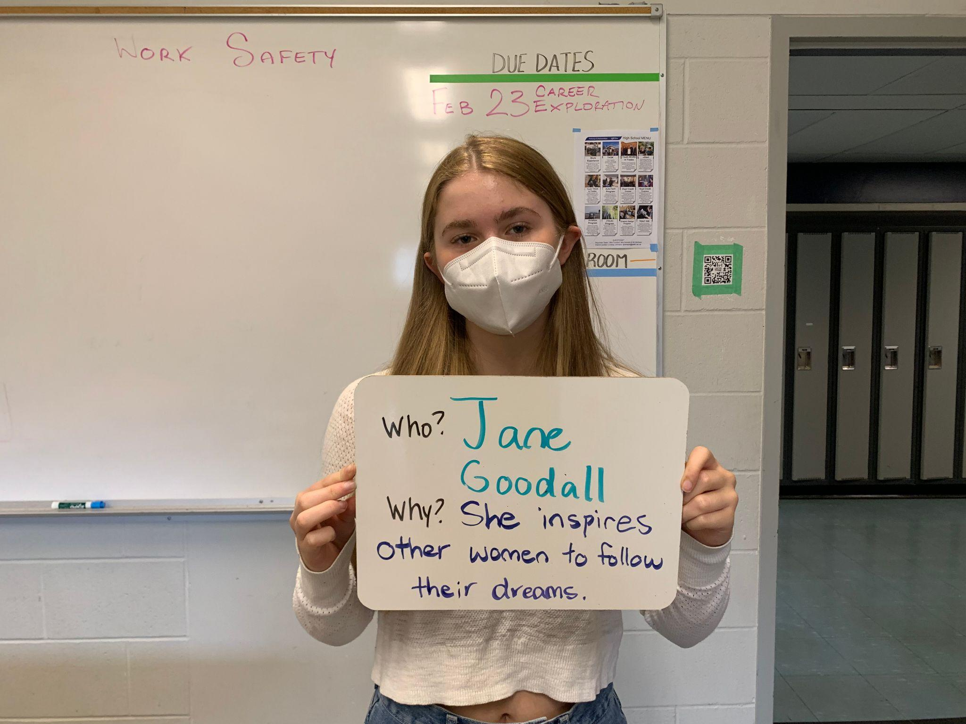

Slide 16
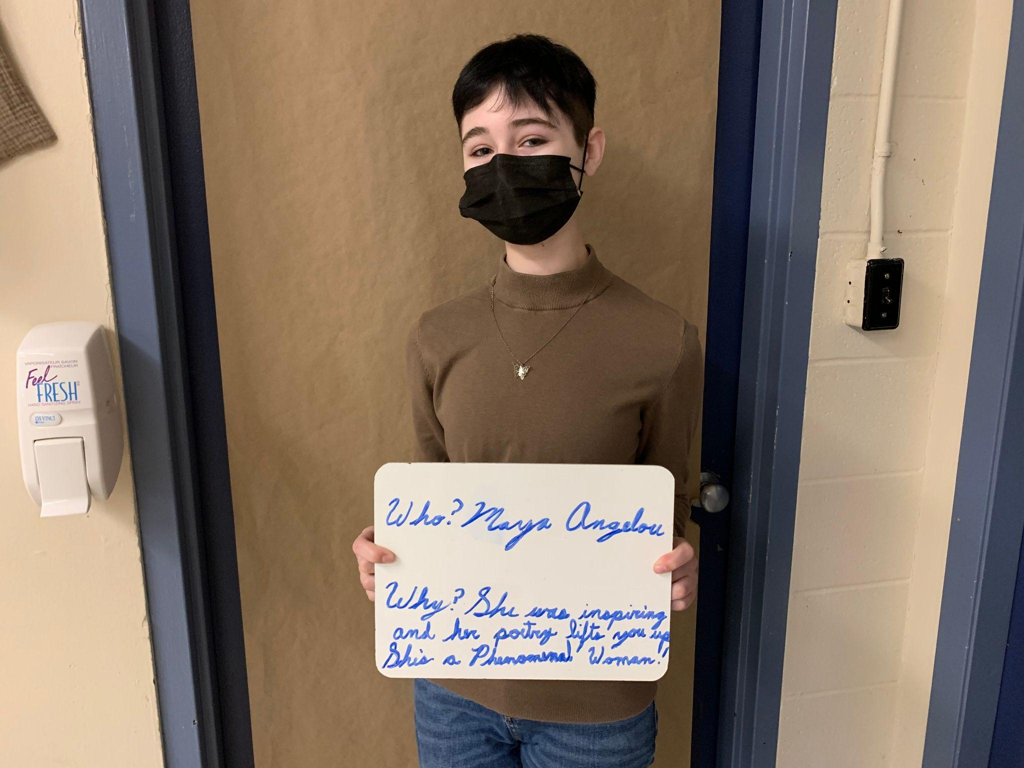

Slide 18
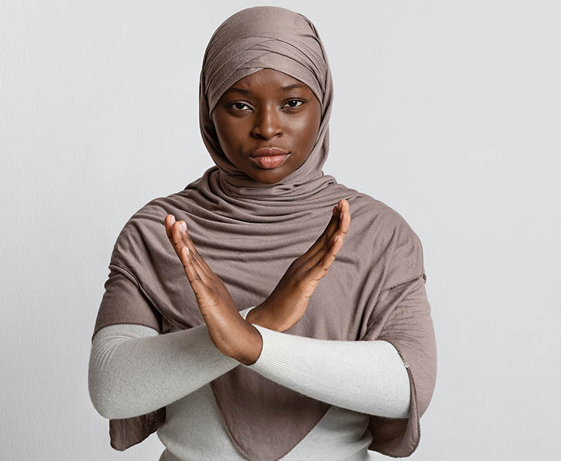

Slide 19
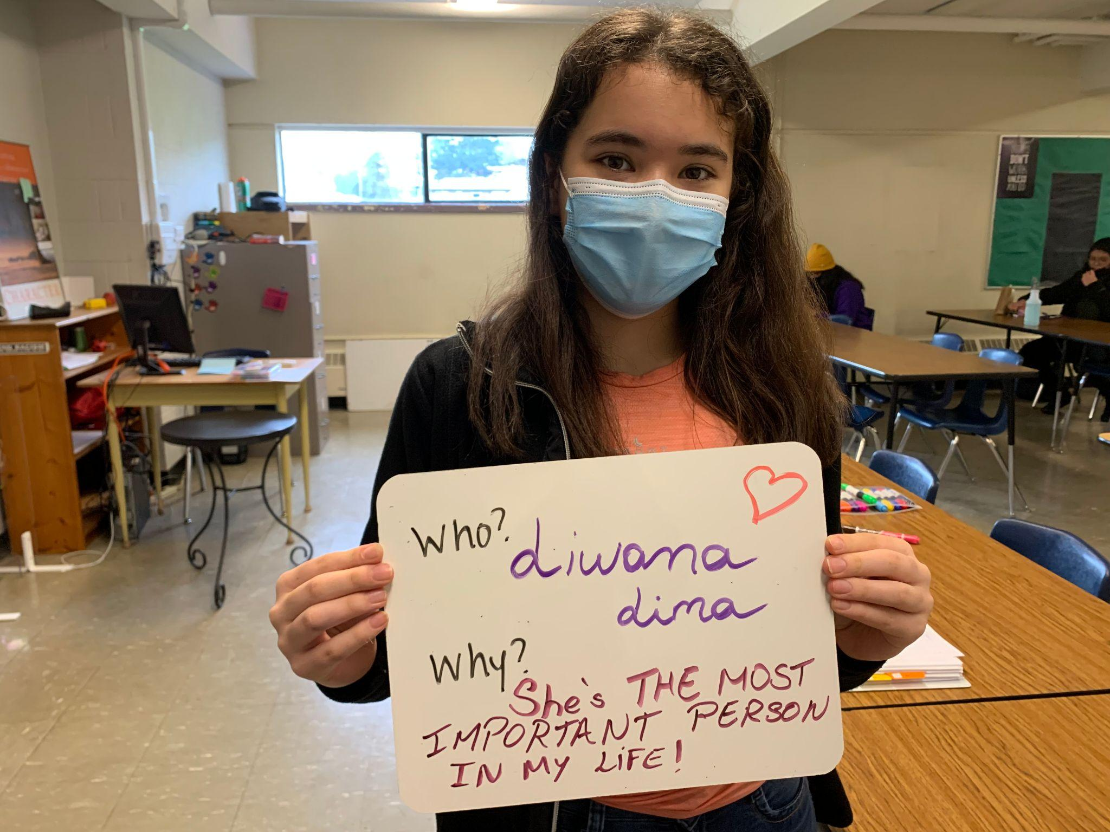

Slide 20
“Women are leaders everywhere you look—from the CEO who runs a Fortune 500 company to the housewife who raises her children and heads her household. Our country was built by strong women, and we will continue to break down walls and defy stereotypes.” - Nancy Pelosi

Slide 21
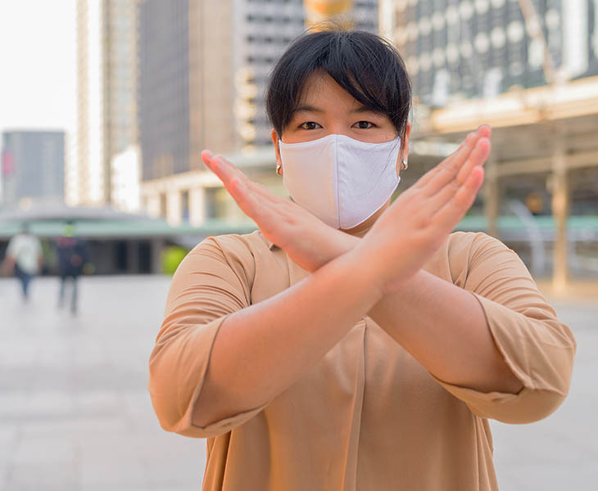

Slide 22
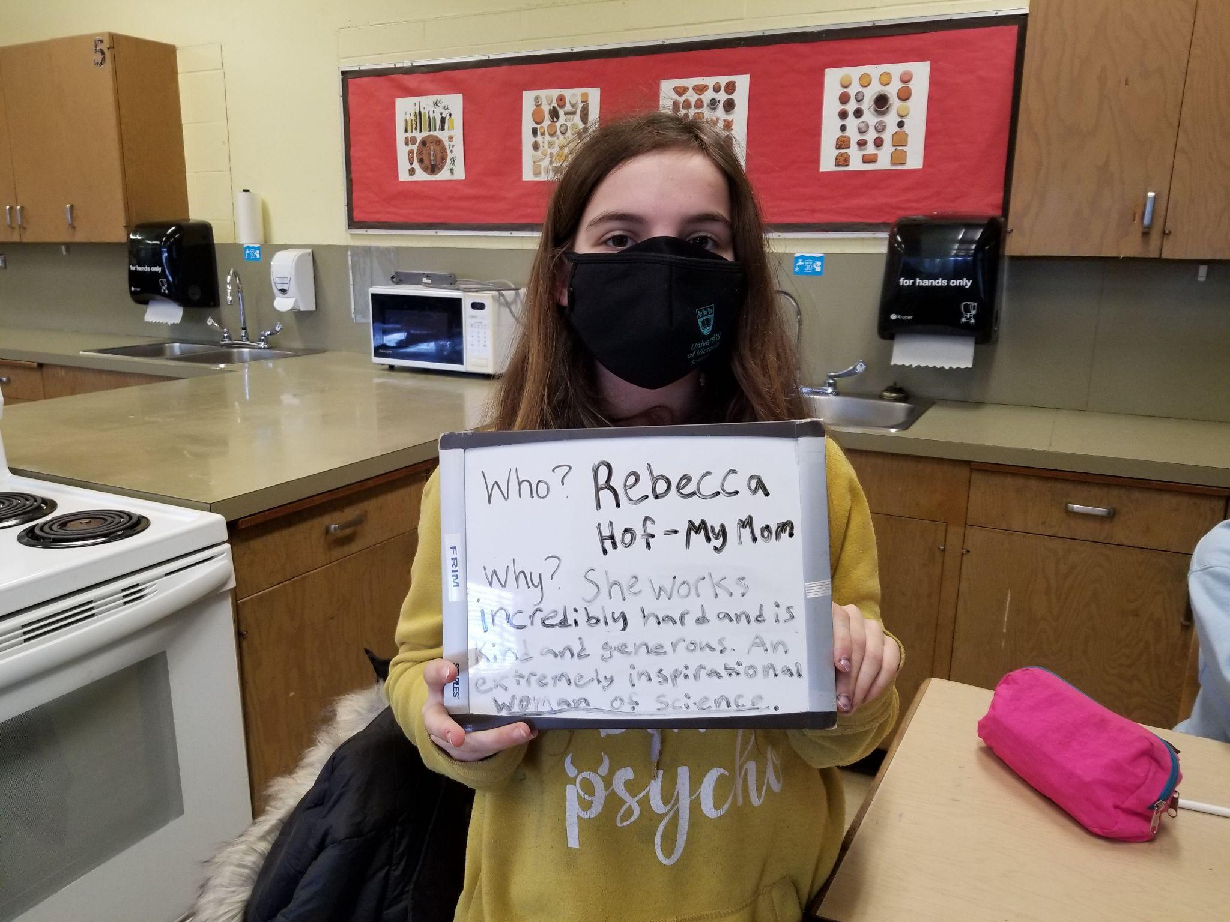

Slide 24
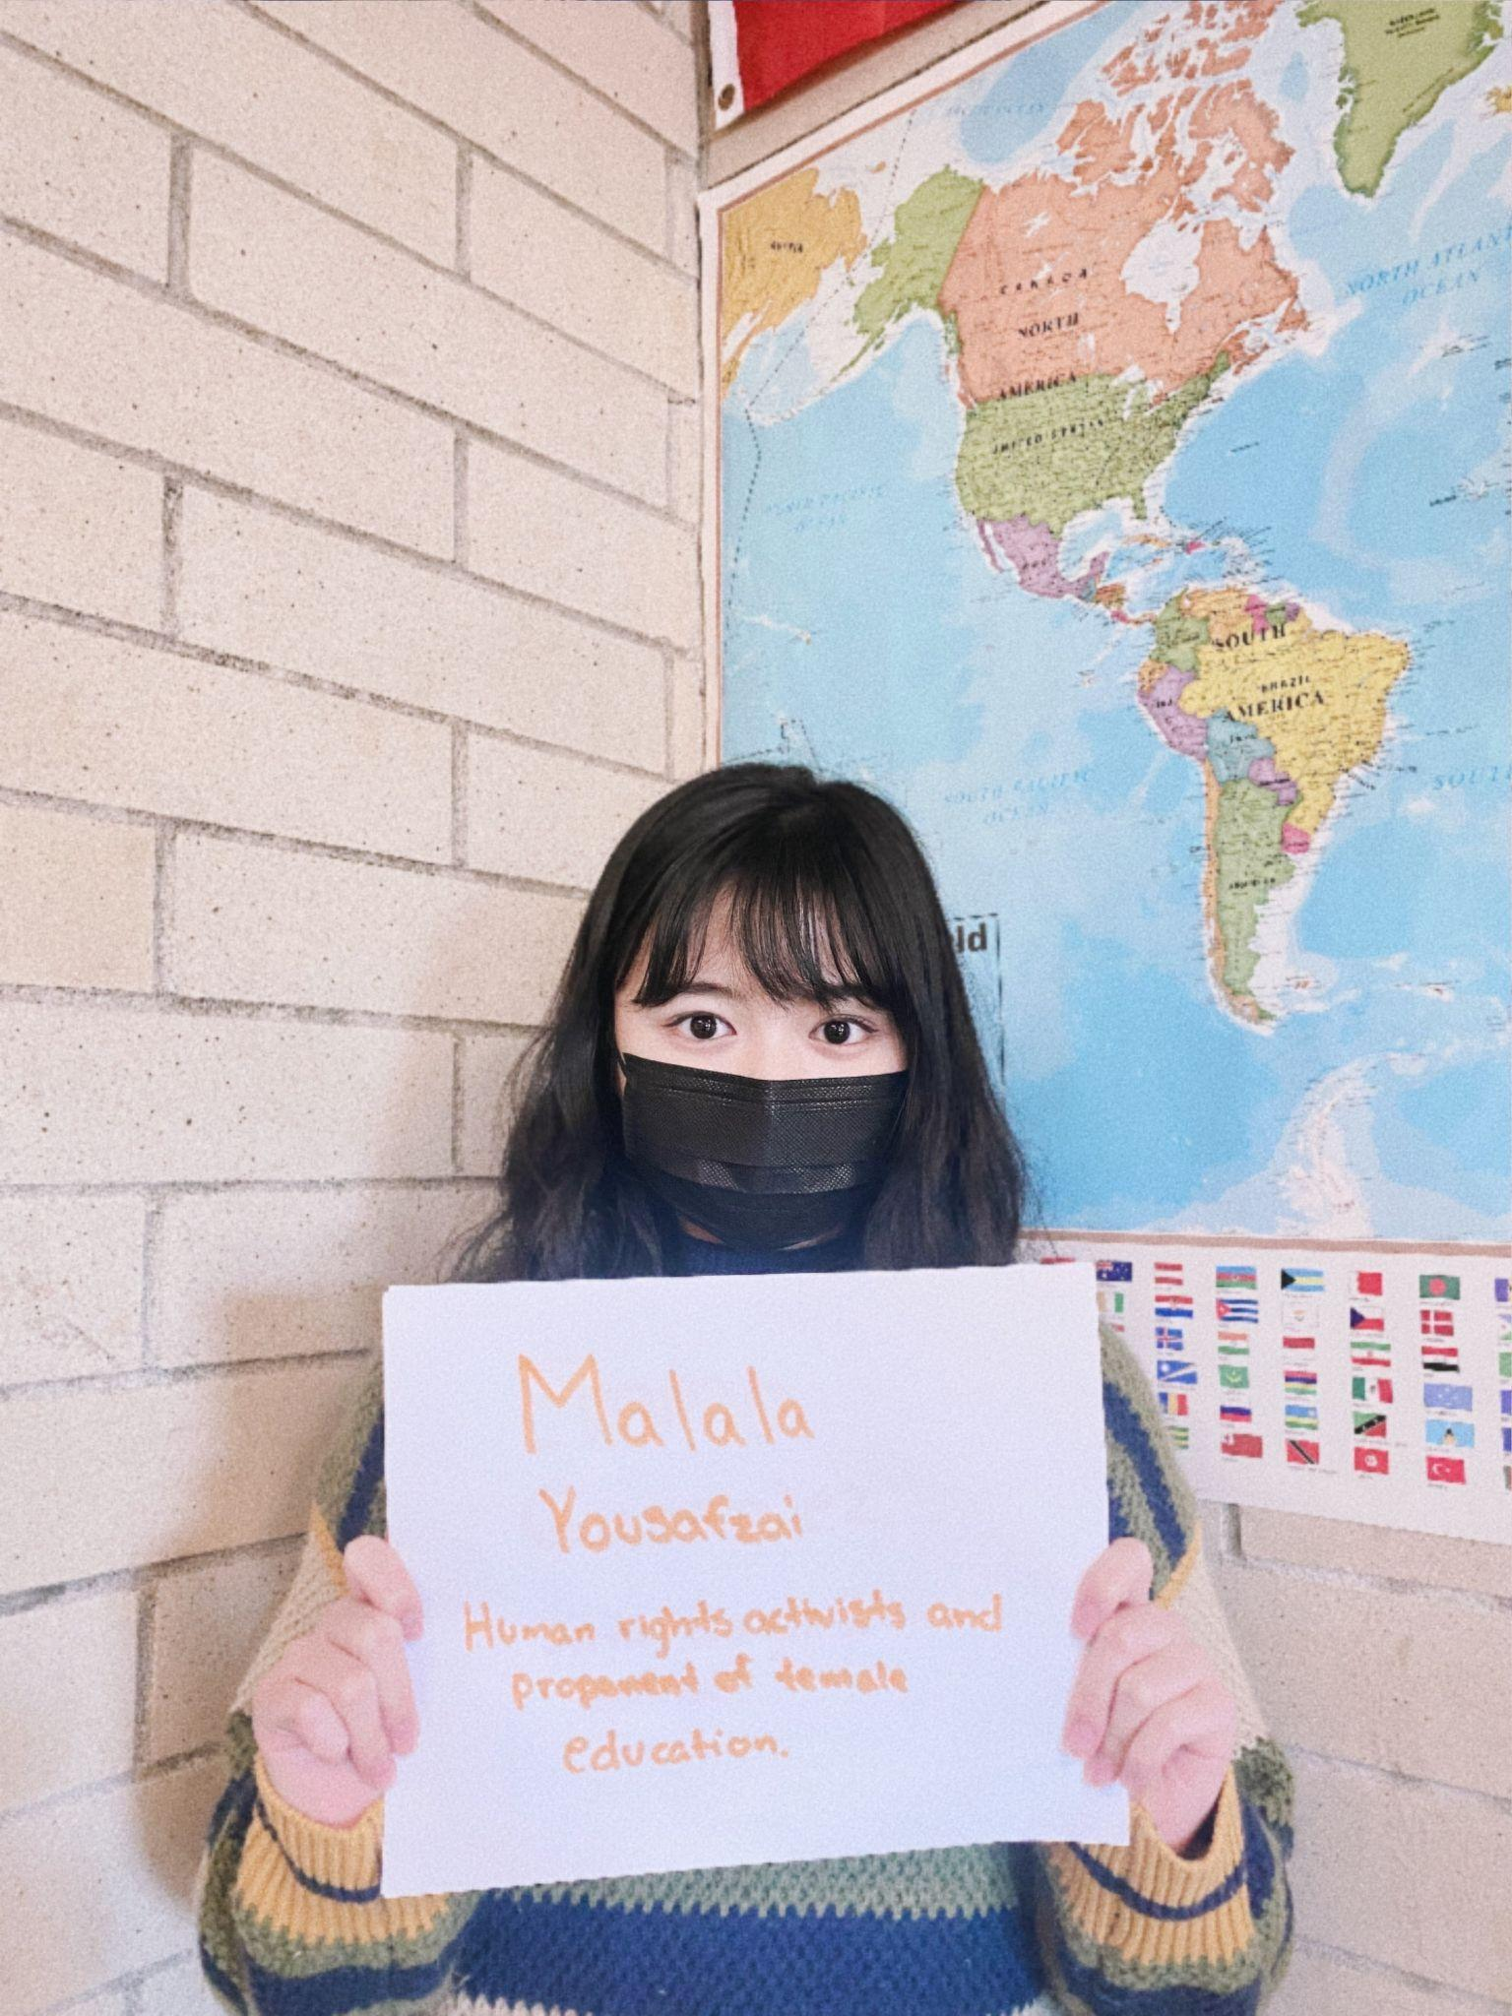

Slide 26
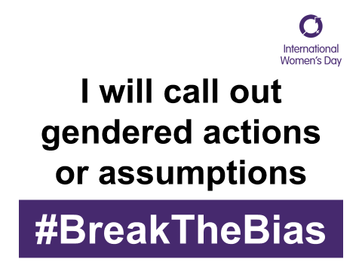

Slide 27
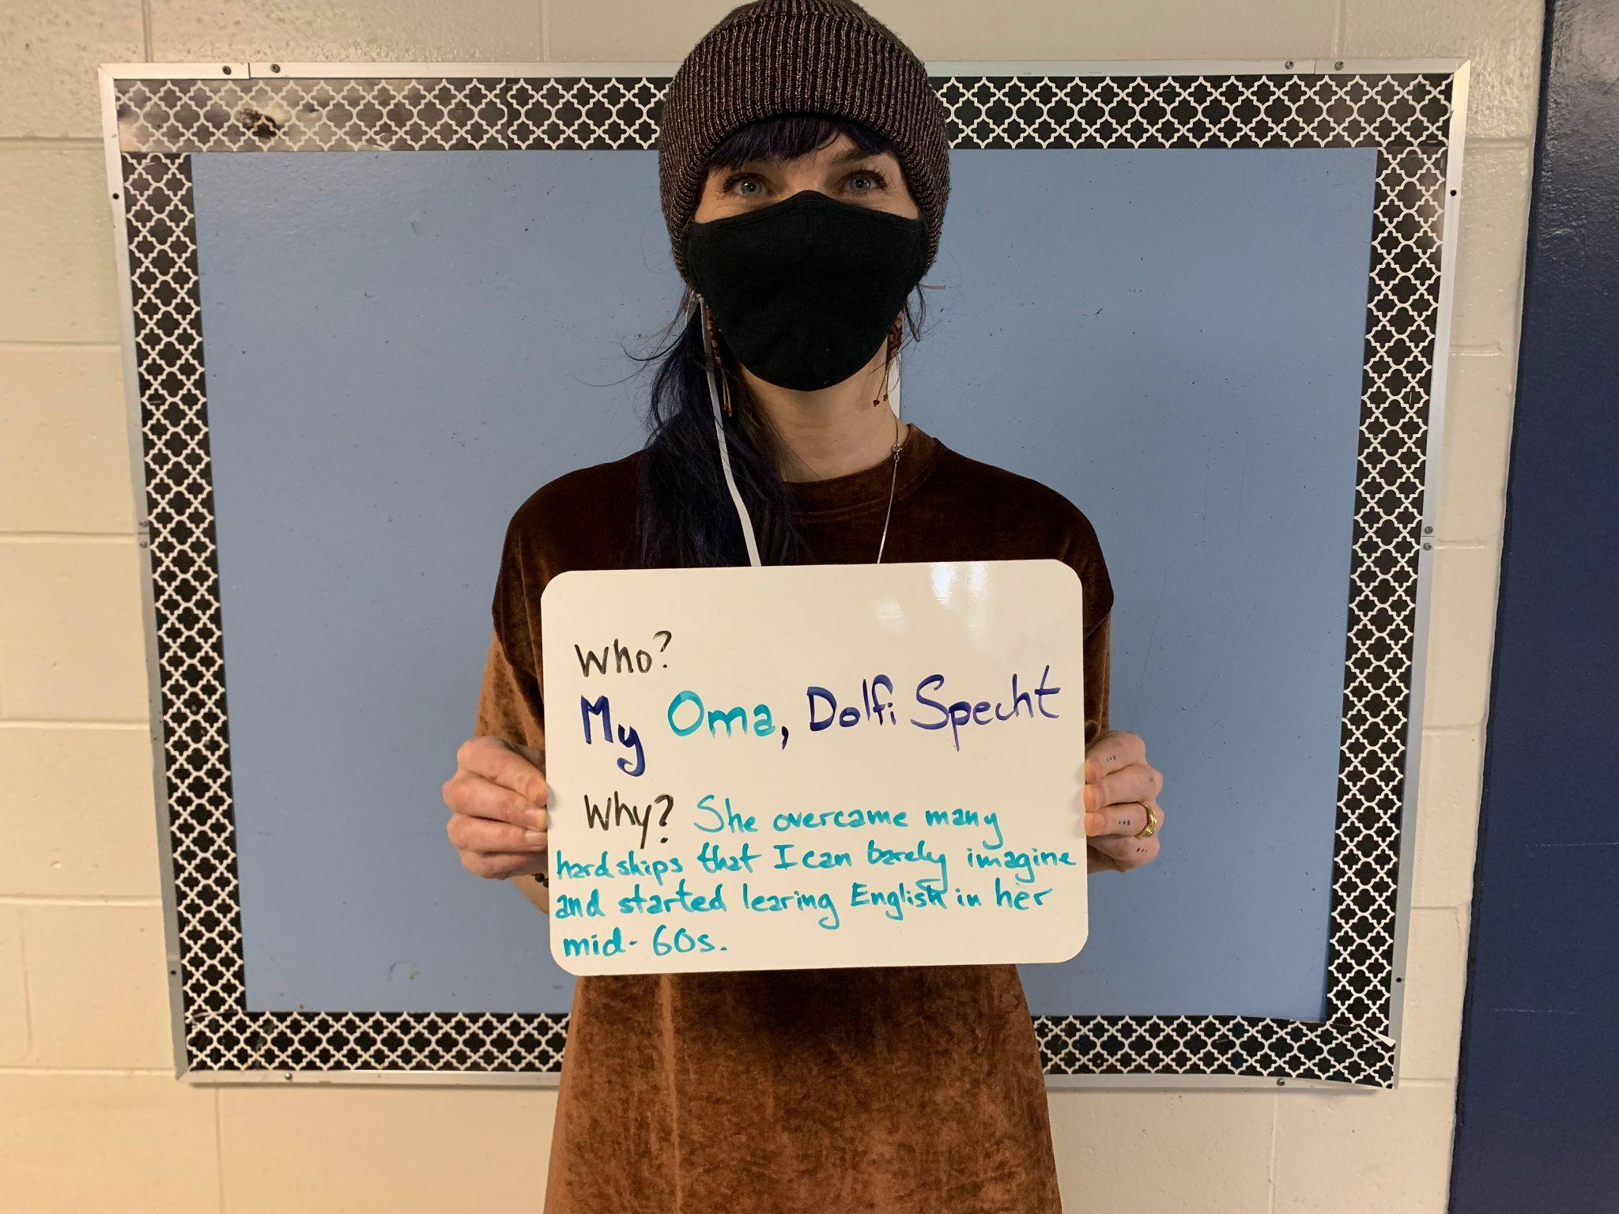

Slide 28
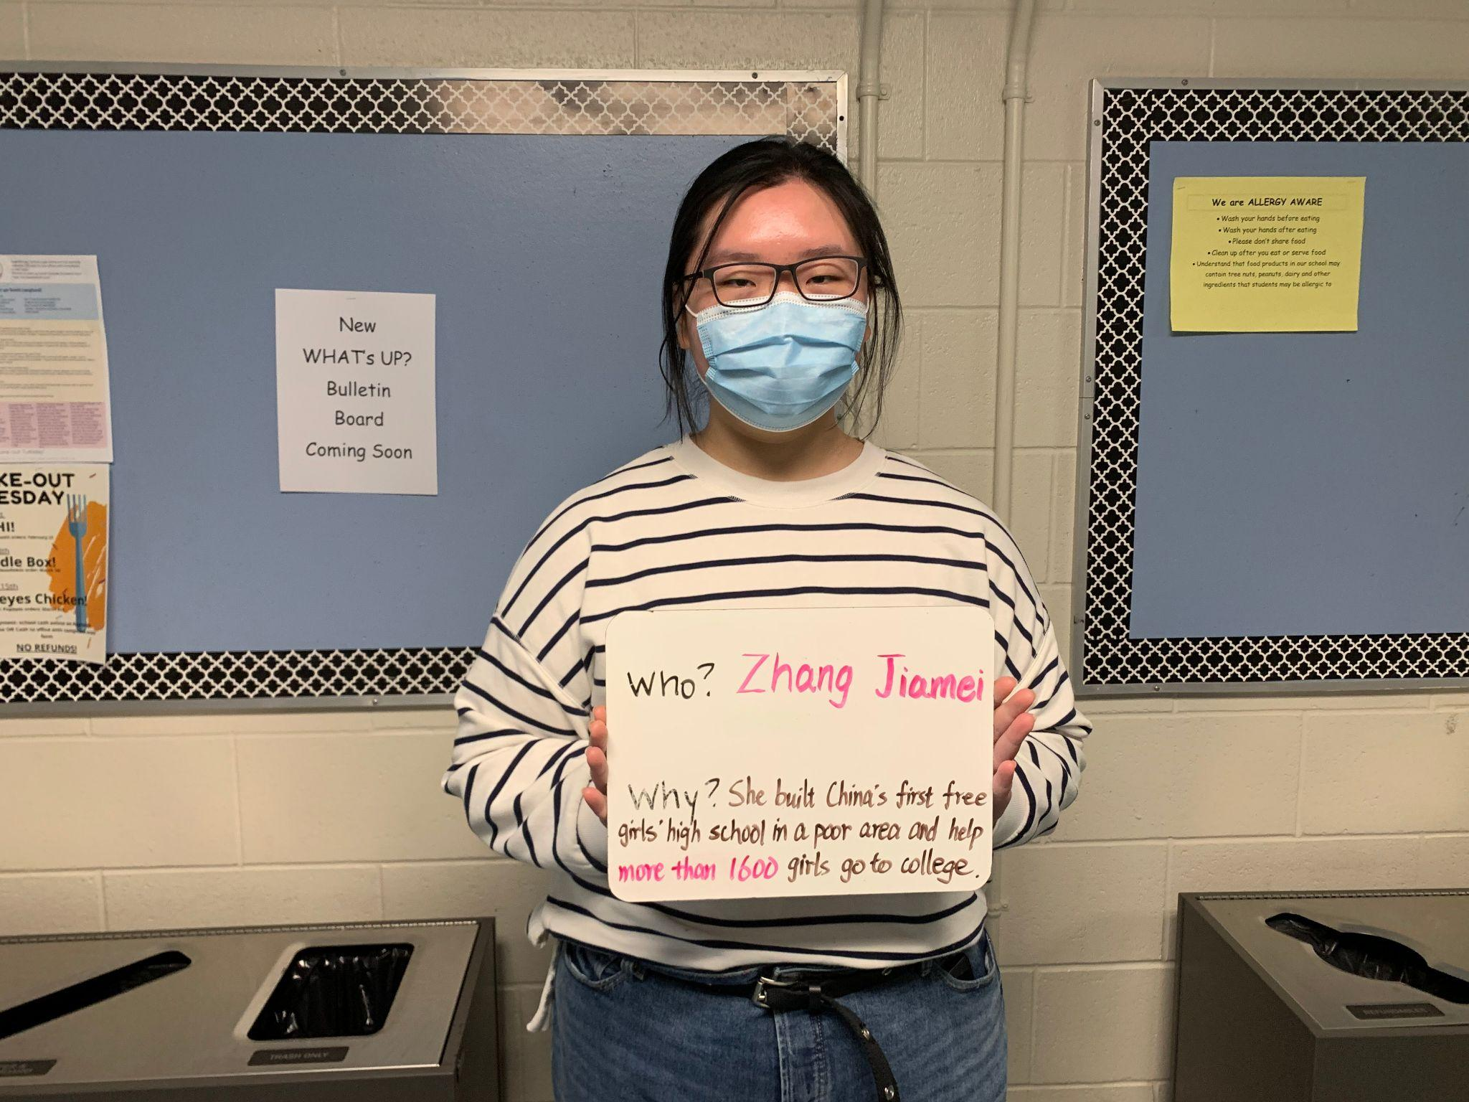

Slide 31
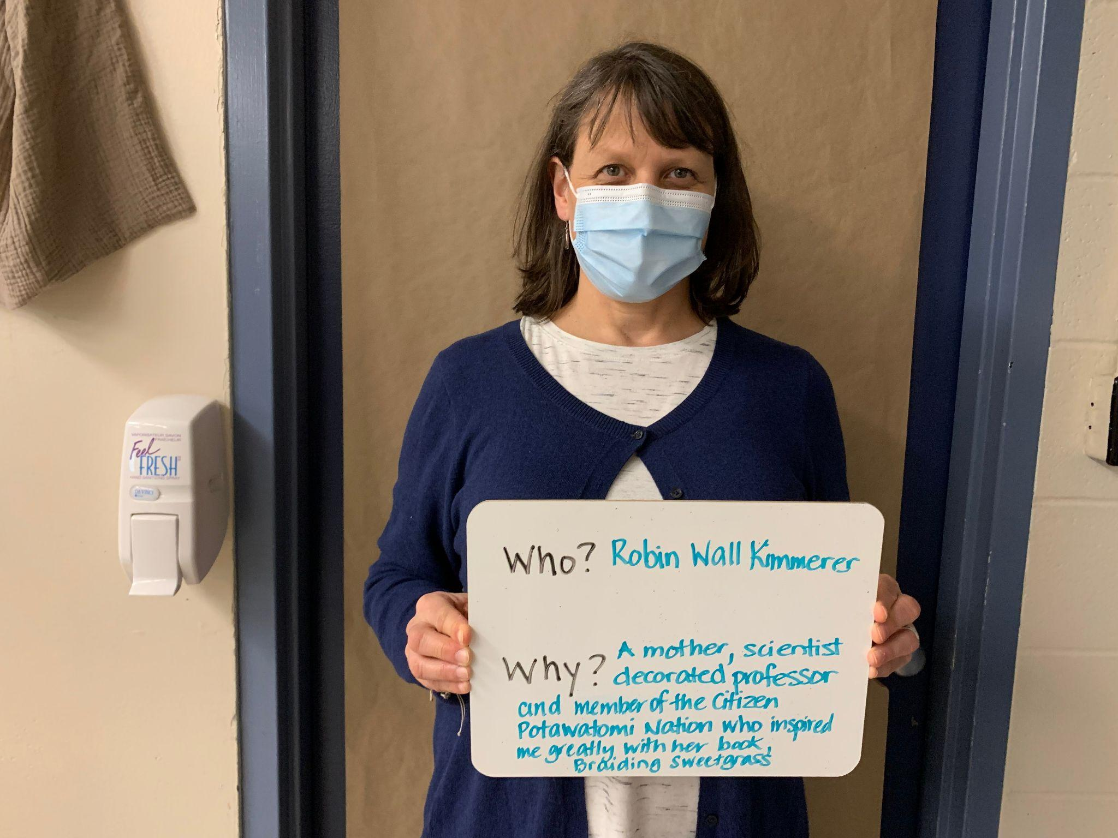

Slide 33
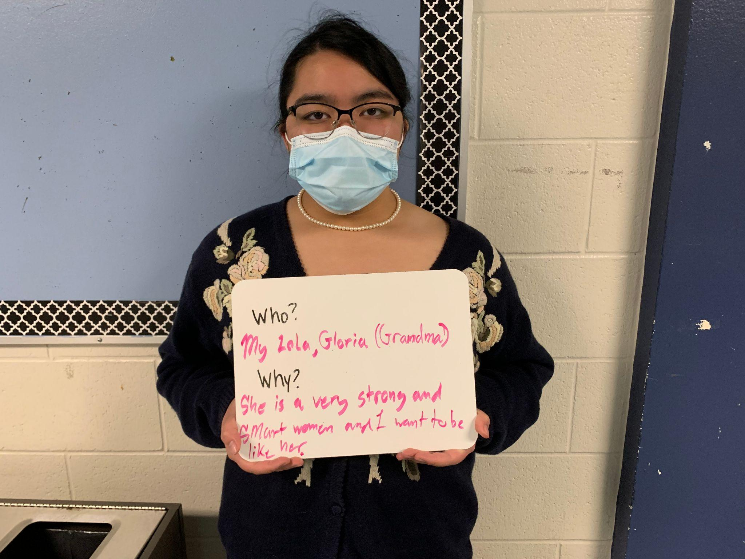

Slide 35
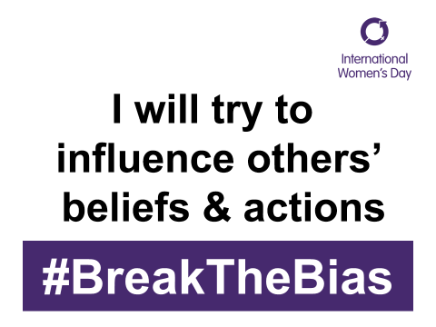

Slide 36
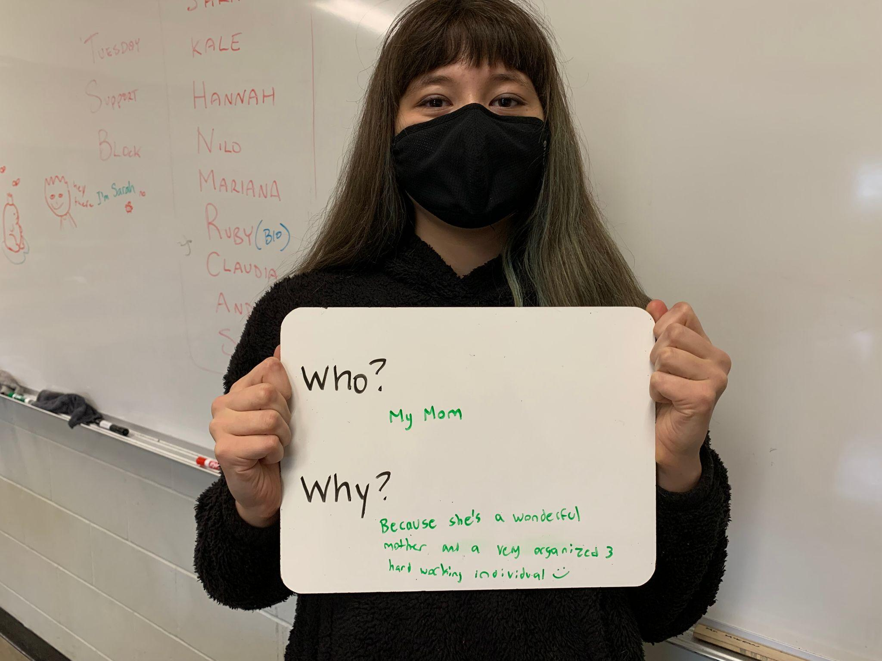

Slide 37
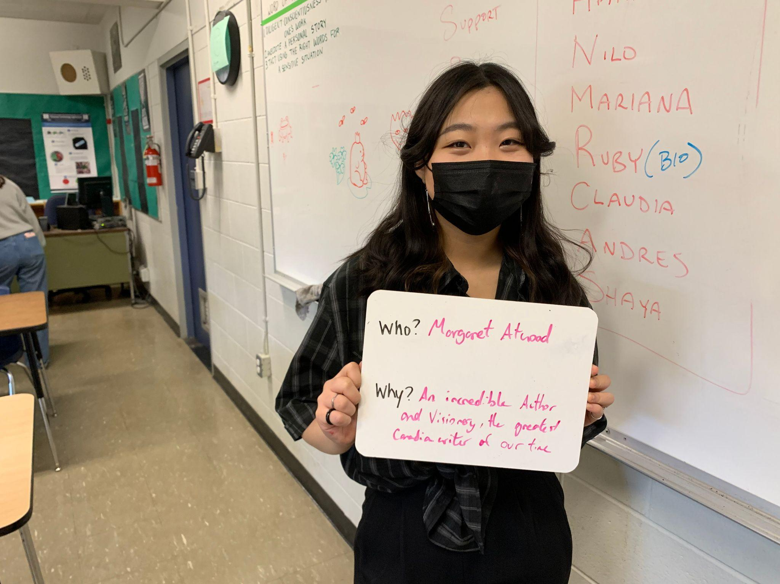

Slide 39
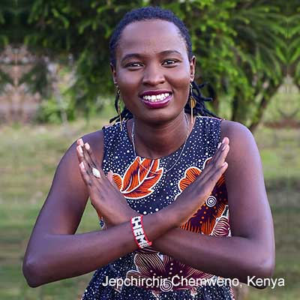

Slide 40
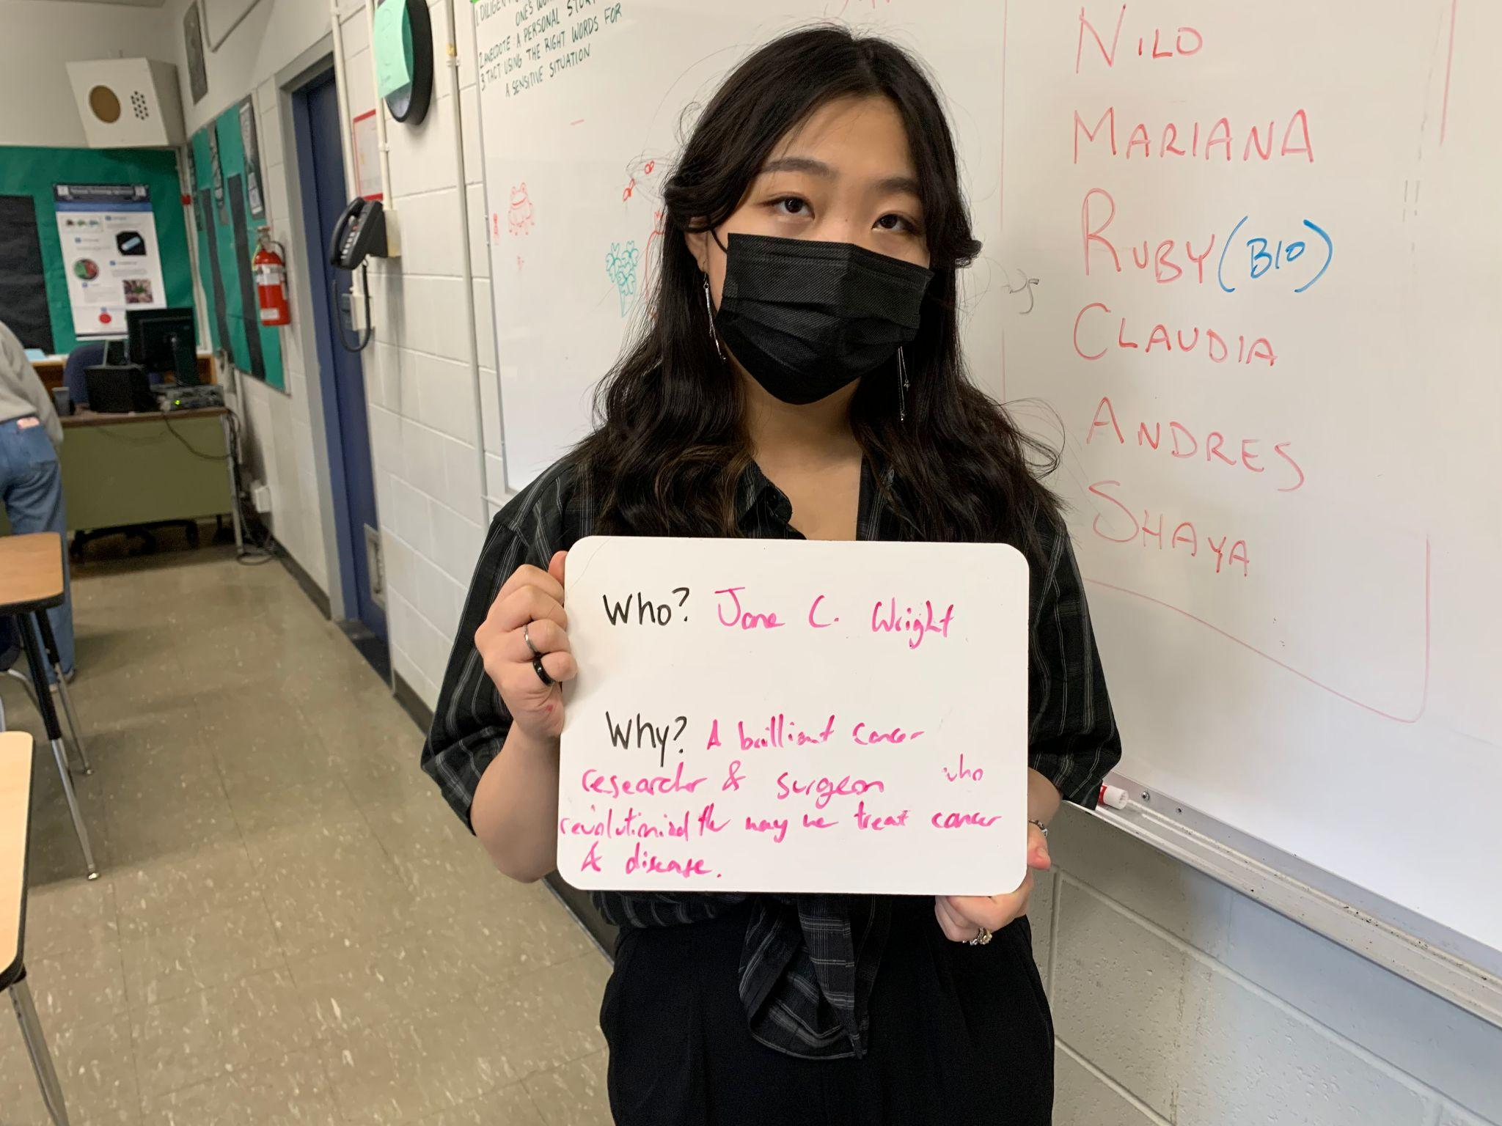

Slide 42
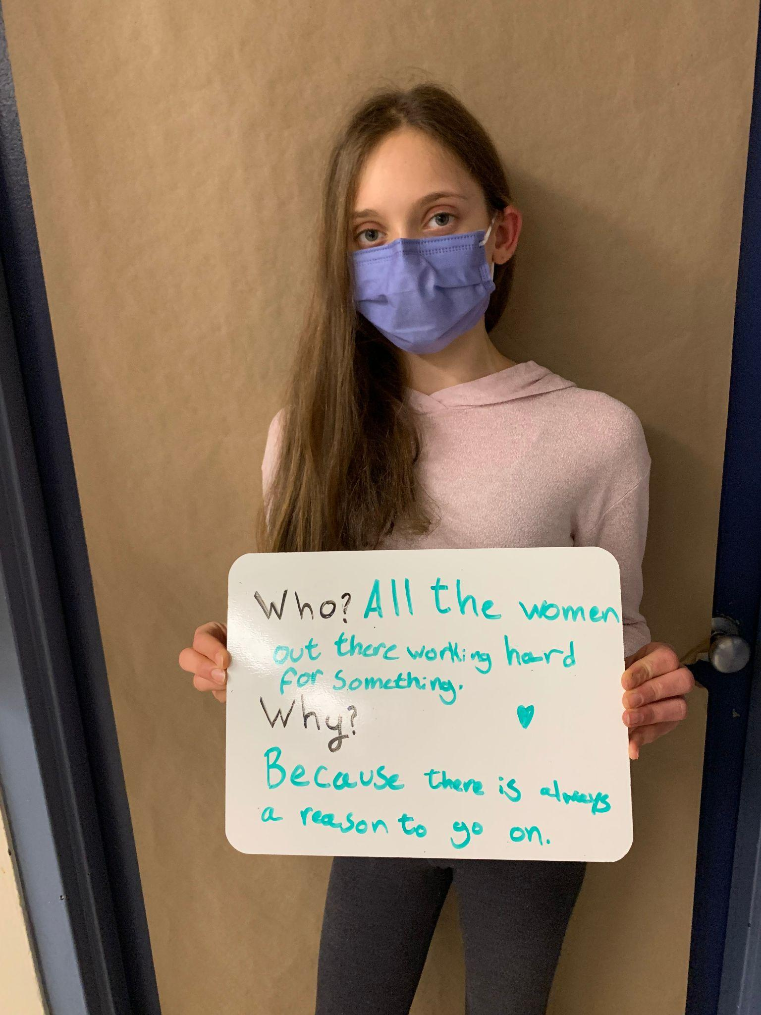

Slide 43
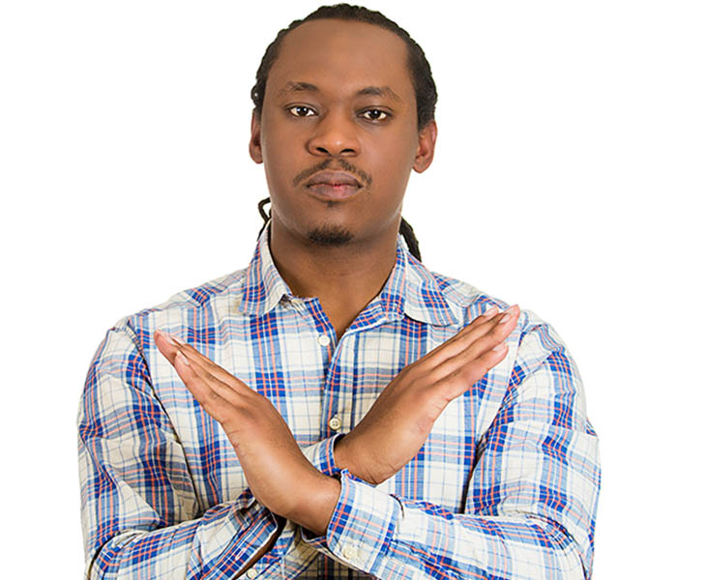

Slide 44
“Don’t expect change to happen overnight, even if it’s not always visible it’s making more impact than you think.”
– Emma Watson

Slide 45
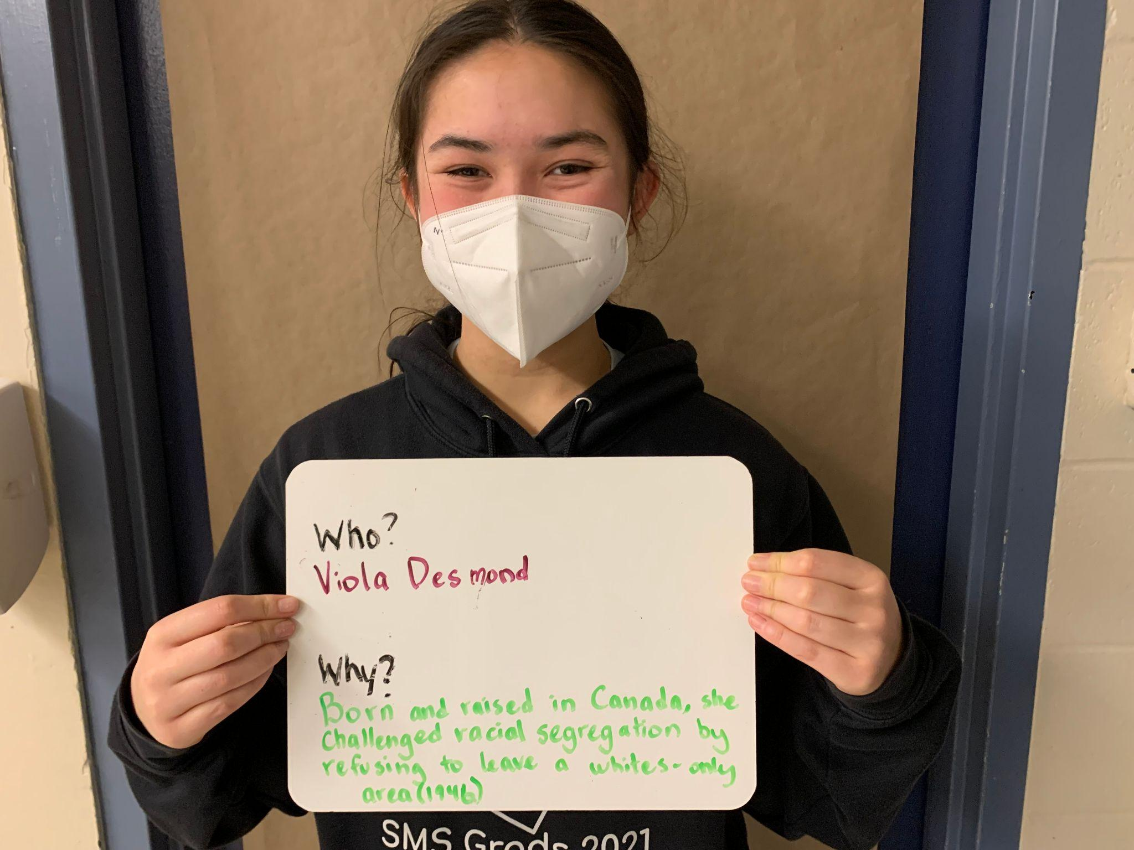

Slide 46
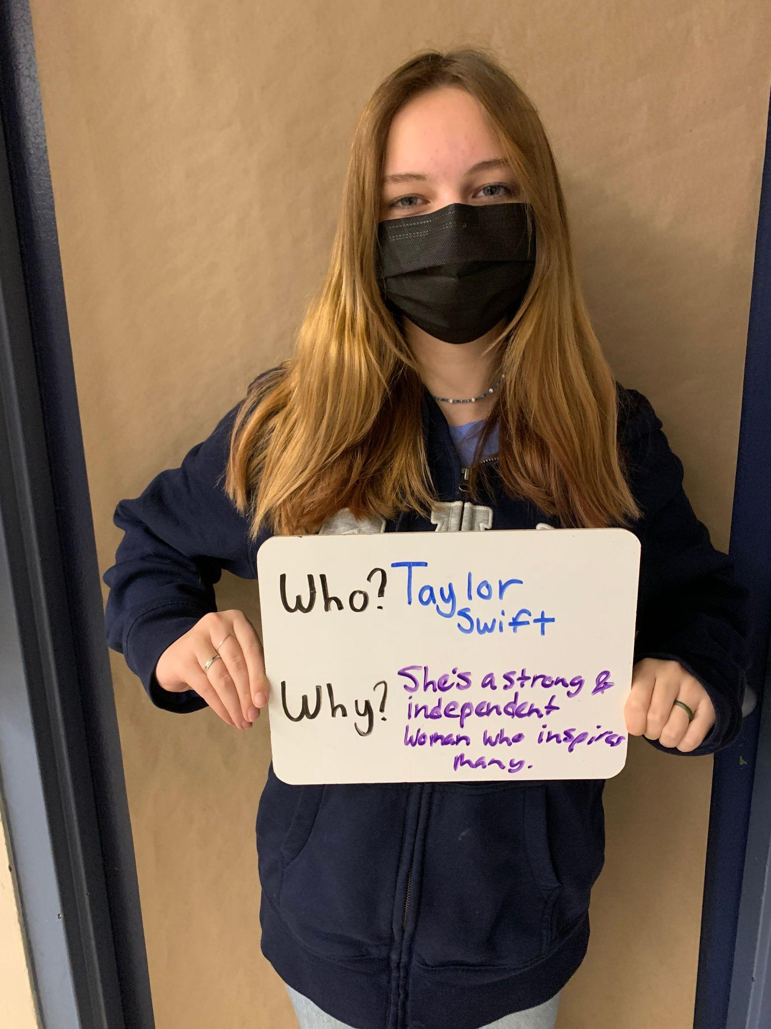

Slide 47
“If you have a dream, make it a goal.” –Unknown

Slide 48
“Imagine a gender equal world. A world free of bias, stereotypes and discrimination. A world that's diverse, equitable, and inclusive. A world where difference is valued and celebrated. Together we can forge women's equality. Collectively we can all #BreakTheBias. Celebrate women's achievement. Raise awareness against bias. Take action for equality.” https://www.internationalwomensday.com/

