Slide 1
Communication
Being able to Speak to an Audience

Slide 2
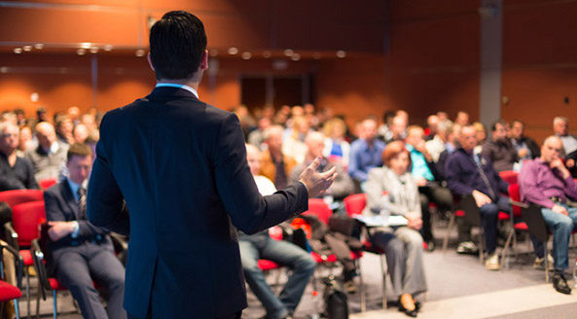
Perhaps the most important aspect of communication to develop is being comfortable speaking to a group.
Once you can do this, you have the foundation for all other forms of communication.

Slide 3
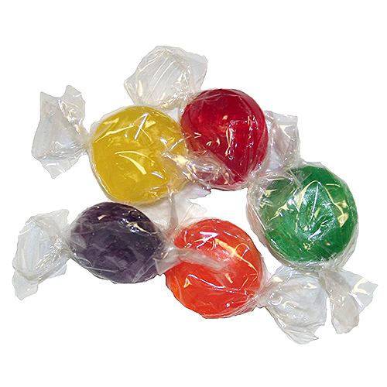
Step 1:
Come and get a candy! You MUST NOT eat the candy yet!
If you want to trade your candy you have 20 seconds to do so.
Once you have a candy, find another person with the same kind of candy to form a group of 2.

Slide 4
Step 2:
You have 10 seconds to decide who will go first!
You are going to read tongue twisters to each other. The goal is to read clearly and enunciate NOT to read fast!
CONTINUE READING THE TONGUE TWISTER REPEATEDLY FOR 30 SECONDS.
Partner 1= reads first----30 seconds
Partner 2= reads second----30 seconds

Slide 5
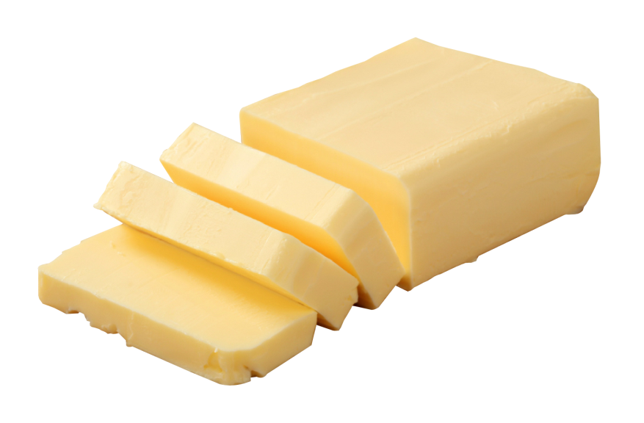
Partner 1
Betty Botter bought some butter But she said the butter’s bitter If I put it in my batter, it will make my batter bitter But a bit of better butter will make my batter better So it was better Betty Botter bought a bit of better butter

Slide 6
Partner 2
Through three cheese trees three free fleas flew. While these fleas flew, freezy breeze blew. Freezy breeze made these three trees freeze. Freezy trees made these trees' cheese freeze. That's what made these three free fleas sneeze.

Slide 7
Step 3:
Come to the front of the room if you have a lemon candy and were PARTNER 2 in your group.
Any other volunteers?

Slide 8
Find another group of 2 and form a group of 4; once you have a group of 4, start clapping.
Group of 4 activity= “Continuous story”
One person starts telling a story (that they make up) for 20 seconds—the next person continues the story for 20 seconds—etc.
We will continue for 2 minutes. The goal is to have the story make sense…you need to listen to the previous speaker!
Start the story with “Once upon a time…”

Slide 9
Independent work! You have 30 seconds to summarize your group’s story. You WILL be sharing your summary!
Small Group Sharing= each person has 30 seconds to share their summary. You must talk for the entire 30 seconds!

Slide 10
Come to the front of the room if you have a lime candy.
Share your summary of your story (30 seconds!) Start the story with “Once upon a time…”
Volunteers?

